Slide 1
Designing Application Specific Embedded Processors
Adaptive Differential Pulse Code Modulation
Group: Asip01
Hamza Aziz Ahmad, Paul Morof, Ye Zhu

Slide 2
Strcuture of our presentation
Introduction to our 2 CPUs
Benefits / Benchmarks
Problems
Q & A

Slide 3
Original C-Code
[…]
for ( ; len > 0 ; len-- ) {
/* Step 1 - get the delta value */
if ( bufferstep ) {
delta = inputbuffer & 0xf;
} else {
inputbuffer = *indata++;
delta = (inputbuffer >> 4) & 0xf;
}
bufferstep = !bufferstep;
/* Step 2 - Find new index value (for later) */
index += indexTable[delta];
if ( index < 0 ) index = 0;
if ( index > 88 ) index = 88;
/* Step 3 - Separate sign and magnitude */
sign = delta & 8;
delta = delta & 7;
/* Step 4 - Compute difference and new predicted value */
/*
** Computes 'vpdiff = (delta+0.5)*step/4', but see comment
** in adpcm_coder.
*/
vpdiff = step >> 3;
if ( delta & 4 ) vpdiff += step;
if ( delta & 2 ) vpdiff += step>>1;
if ( delta & 1 ) vpdiff += step>>2;
if ( sign )
valpred -= vpdiff;
else
valpred += vpdiff;
/* Step 5 - clamp output value */
if ( valpred > 32767 )
valpred = 32767;
else if ( valpred < -32768 )
valpred = -32768;
/* Step 6 - Update step value */
step = stepsizeTable[index];
/* Step 7 - Output value */
[…]
#define signedUnsignedModification 0x8000
#if PRINT_ARRAY
t_print(separator);
t_printHex( (valpred+signedUnsignedModification) & 0xFFFF, 4);
if (printCounter%10==9) separator=",\r\n";
else separator=", ";
printCounter++;
#else
if (printCounter&1)
writeToAudioOutL( (valpred+signedUnsignedModification) & 0xFFFF);
else writeToAudioOutR( (valpred+signedUnsignedModification) & 0xFFFF);
printCounter++;
#endif
}
[…]

Slide 4
Original C-Code
[…]
for ( ; len > 0 ; len-- ) {
/* Step 1 - get the delta value */
if ( bufferstep ) {
delta = inputbuffer & 0xf;
} else {
inputbuffer = *indata++;
delta = (inputbuffer >> 4) & 0xf;
}
bufferstep = !bufferstep;
/* Step 2 - Find new index value (for later) */
index += indexTable[delta];
if ( index < 0 ) index = 0;
if ( index > 88 ) index = 88;
/* Step 3 - Separate sign and magnitude */
sign = delta & 8;
delta = delta & 7;
/* Step 4 - Compute difference and new predicted value */
/*
** Computes 'vpdiff = (delta+0.5)*step/4', but see comment
** in adpcm_coder.
*/
vpdiff = step >> 3;
if ( delta & 4 ) vpdiff += step;
if ( delta & 2 ) vpdiff += step>>1;
if ( delta & 1 ) vpdiff += step>>2;
if ( sign )
valpred -= vpdiff;
else
valpred += vpdiff;
/* Step 5 - clamp output value */
if ( valpred > 32767 )
valpred = 32767;
else if ( valpred < -32768 )
valpred = -32768;
/* Step 6 - Update step value */
step = stepsizeTable[index];
/* Step 7 - Output value */
[…]
#define signedUnsignedModification 0x8000
#if PRINT_ARRAY
t_print(separator);
t_printHex( (valpred+signedUnsignedModification) & 0xFFFF, 4);
if (printCounter%10==9) separator=",\r\n";
else separator=", ";
printCounter++;
#else
if (printCounter&1)
writeToAudioOutL( (valpred+signedUnsignedModification) & 0xFFFF);
else writeToAudioOutR( (valpred+signedUnsignedModification) & 0xFFFF);
printCounter++;
#endif
}
[…]

Slide 5
Differences
CPU 1
CPU 2
A lot of additional hardware (i.e. a second ALU, multiple Multiplexer) . We added what we considered to be helpful.
Very “big” special instructions. Mostly with fix coded bounds. Not very useful for any other project
No additional hardware
Small reusable instructions

Slide 6
Our Modifications
Original
CPU 1
if ( index < 0 ) index = 0;
if ( index > 88 ) index = 88;
[…]
if ( sign )
valpred -= vpdiff;
else
valpred += vpdiff;
[…]
if ( valpred > 32767 )
valpred = 32767;
else if ( valpred < -32768 )
valpred = -32768;
index = index_value(index);
[…]
valpred = valpred1(valpred , vpdiff , sign);
[…]
valpred = valpred_value(valpred);

Slide 7
Our Modifications
Original
CPU 1
if ( index < 0 ) index = 0;
if ( index > 88 ) index = 88;
[…]
if ( sign )
valpred -= vpdiff;
else
valpred += vpdiff;
[…]
if ( valpred > 32767 )
valpred = 32767;
else if ( valpred < -32768 )
valpred = -32768;
index = index_value(index);
[…]
valpred = valpred1(valpred , vpdiff , sign);
[…]
valpred = valpred_value(valpred);

Slide 8
Our Modifications
Original
CPU 2
if ( index < 0 ) index = 0;
if ( index > 88 ) index = 88;
[…]
if ( sign )
valpred -= vpdiff;
else
valpred += vpdiff;
[…]
if ( valpred > 32767 )
valpred = 32767;
else if ( valpred < -32768 )
valpred = -32768;
index = asslt(index, 0);
index = assgt(index, 88);
[…]
valpred = valpred_sub (valpred , vpdiff , sign);
valpred = valpred_add (valpred , vpdiff , sign);
[…]
valpred = assgt(valpred, 32767);
valpred = asslt(valpred, -32768);

Slide 9
Our Modifications
Original
CPU 2
if ( index < 0 ) index = 0;
if ( index > 88 ) index = 88;
[…]
if ( sign )
valpred -= vpdiff;
else
valpred += vpdiff;
[…]
if ( valpred > 32767 )
valpred = 32767;
else if ( valpred < -32768 )
valpred = -32768;
index = asslt(index, 0);
index = assgt(index, 88);
[…]
valpred = valpred_sub (valpred , vpdiff , sign);
valpred = valpred_add (valpred , vpdiff , sign);
[…]
valpred = assgt(valpred, 32767);
valpred = asslt(valpred, -32768);

Slide 10
New implemented instructions
CPU 1
CPU 2
index_value
Index_value rd rs0 $0
valpred1
valpred_value rd rs0 $0
valpred_value
valpred rd r0 rs1 rs2
asslt
asslt rd rs0 rs1
assgt
assgt rd rs0 rs1
valpred_sub
valpred_sub rd rs0 rs1 rs2
valpred_add
valpred_add rd rs0 rs1 rs2

Slide 11
Example comparison
CPU1 – Index_value rd rs0 $0
CPU2 – asslt rd rs0 rs1
wire [31:0] index0;
wire [31:0] result1;
FETCH()
index0 = GPR.read0(rs0); } 3{
wire [31:0] z_32;
wire [31:0] c_88;
wire [3:0] flag;
wire [3:0] flag1;
wire [2:0] tmp_flag;
wire cond1;
wire cond2;
wire cond;
wire [31:0] result;
wire [2:0] tmp_flag1;
wire cond3;
wire cond4;
wire cond5;
z_32 = "00000000000000000000000000000000“;
flag = ALU0.cmp(index0,z_32);
c_88 = "00000000000000000000000001011000";
flag1 = ALU1.cmp(index0,c_88);
tmp_flag = flag[2:0];
cond1 = tmp_flag == \"010\";
cond2 = flag == \"1001\";
cond = cond1 | cond2;
result = MUX.sel(index0,z_32,cond);
tmp_flag1 = flag1[2:0];
cond3 = tmp_flag1 == \"000\";
cond4 = flag1 == \"0011\";
cond5 = cond3 | cond4;
result1 = MUX1.sel(result,c_88,cond5);
null = GPR.write0(rd, result1); } }
wire [31:0] minValue;
wire [31:0] actValue;
wire [31:0] result;
wire [3:0] flag;
FETCH()
actValue = GPR.read0(rs0);
minValue = GPR.read1(rs1);
flag = ALU0.cmp(actValue,minValue);
wire [2:0] tmp_flag;
wire cond1;
wire cond2;
wire cond;
tmp_flag = flag[2:0];
cond1 = tmp_flag == "010";
cond2 = flag == "1001";
cond = cond1 | cond2;
result = (cond) ? minValue : actValue;
null = GPR.write0(rd,result); }

Slide 12
Benchmark

Slide 13
Contents
1
1
Cycles and Execution Time
CPU Area
2
2
2
2
2
Maximal CPU
Maximal CPU
Maximal CPU Frequency
Maximal CPU Frequency
CPU Area
3
3
3
Cycles and Time of Execution
Cycles and Time of Execution
Maximal CPU Frequency
4
4
4
4
4
Power Consumption
Power Consumption
Power Consumption
Power Consumption
Critical Path
5
4
4
4
4
Power and Energy Consumption
Power Consumption
Power Consumption
Power Consumption
Power Consumption

Slide 14
Versions of CPUs
CPU0: The original CPU
CPU1: Optimization for speed
CPU2: Optimization for energy
and area

Slide 15
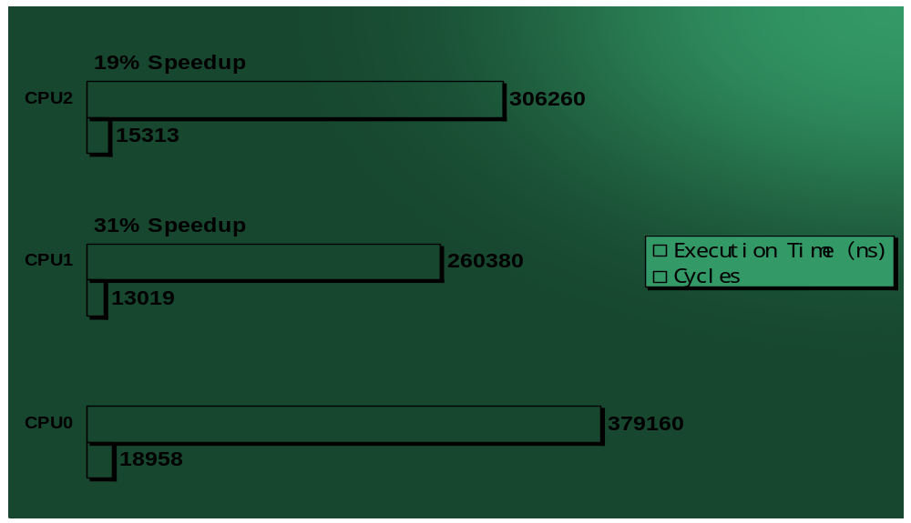
Cycles and Execution Time

Slide 16
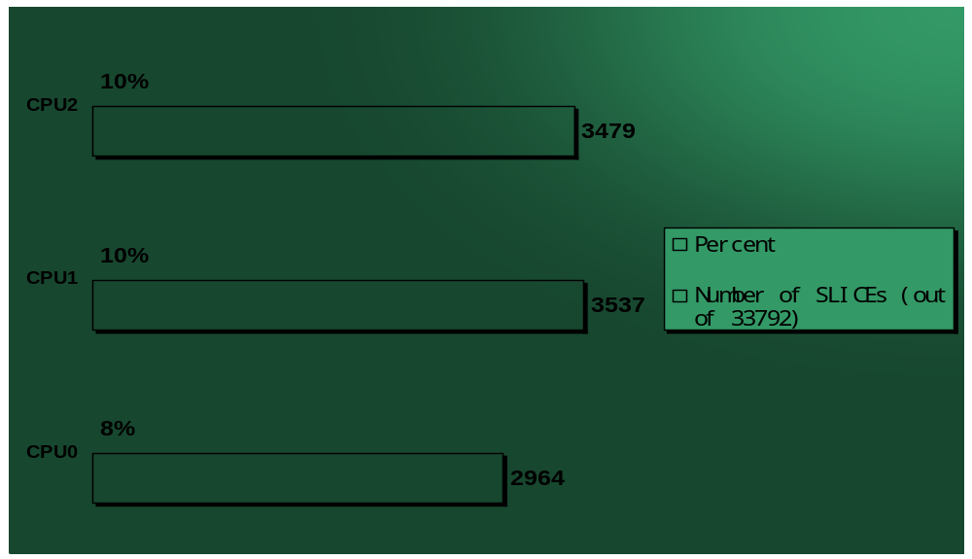
CPU Area

Slide 17
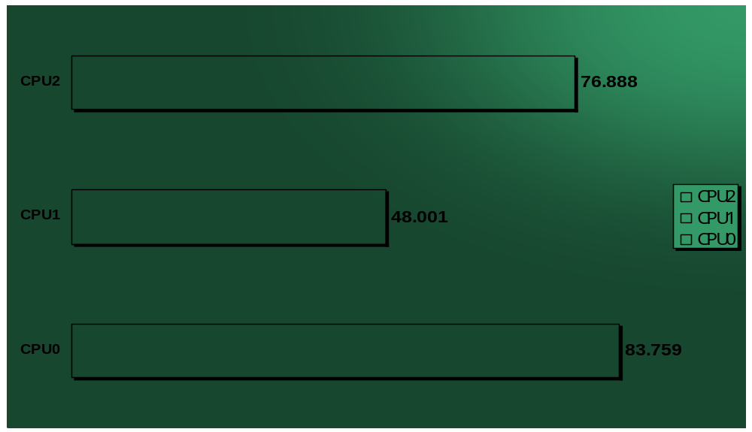
Maximal Frequency

Slide 18
Critical Path
CPU1
CPU2
CPU0
CPU2
Data Path: CPU0/UA_PREG07/DOUT_2 to CPU0/UA_PREG22/DOUT_3
ThemeGallery is a Design Digital Content & Contents mall developed by Guild Design Inc.
Data Path1: CPU0/UA_CTRL/UA_CW_EXE/DOUT_33_3 to CPU0/UA_PREG10/DOUT_2
Data Path2: CPU0/UA_CTRL/UA_CW_EXE/DOUT_30_3 to CPU0/UA_PREG10/DOUT_2.
Data Path: CPU0/UA_CTRL/UA_CW_EXE/DOUT_31_5 to CPU0/UA_PREG13/DOUT_2

Slide 19
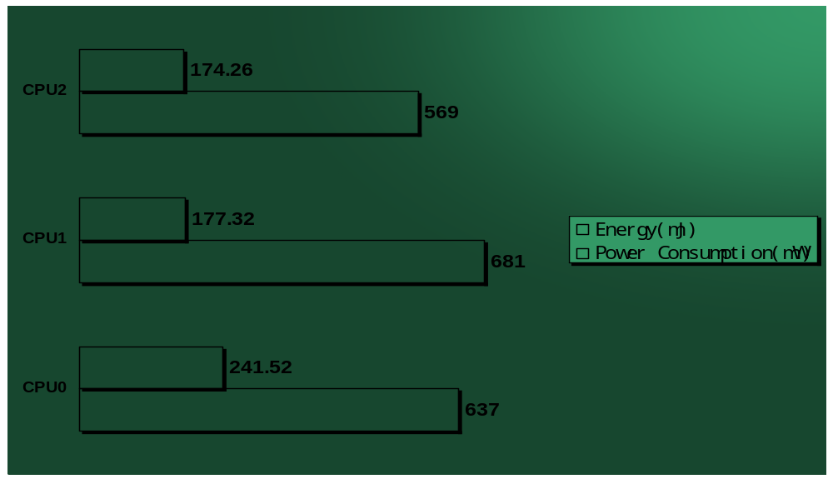
Power and Energy Consumption

Slide 20
Conclusion
Optimization Result
CPU1
obvious much faster
Only execution speed is here consider.
CPU2
less power consumption
but slower
Only one resource ALU ist used here.
Almost Same Energy Consumption

Slide 21
Problem

Slide 22
Problems
Communication problem.
Step 1 has taken a relatively long time.
We were the only group in the laboratory.
Different schedule.

Slide 23
Questions or comments?

Slide 24
Thank you for your attention.

